Slide 1
Presented by
Lion Jay Moughon
International Director
2022 – 2024
The Successful Zone Chairperson
Notes:
Survey Audience: What is your current position in the organization?
Experienced zone chairs – have held position for more than one year
Newly appointed zone chairs – serving for the first time
Other district officers:

Slide 2
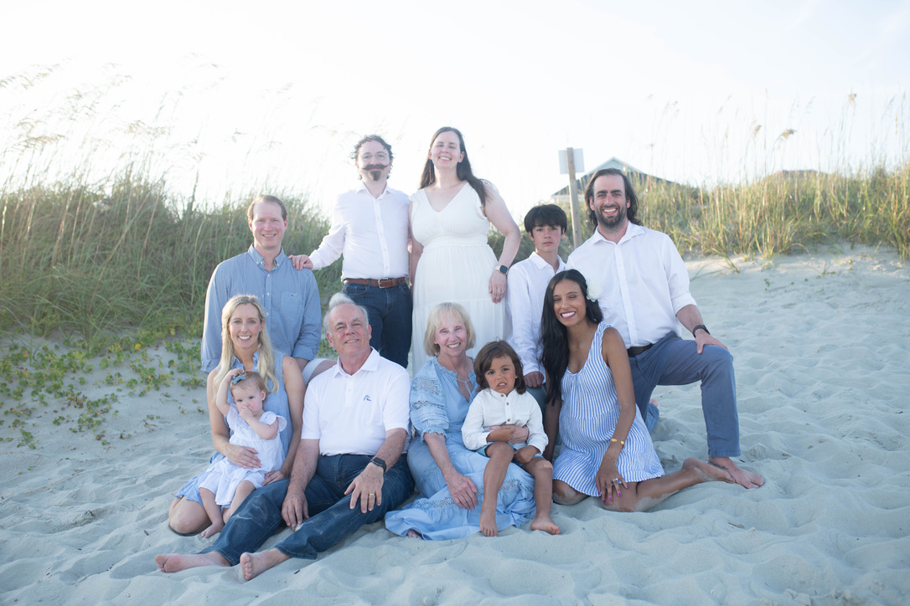

Slide 3
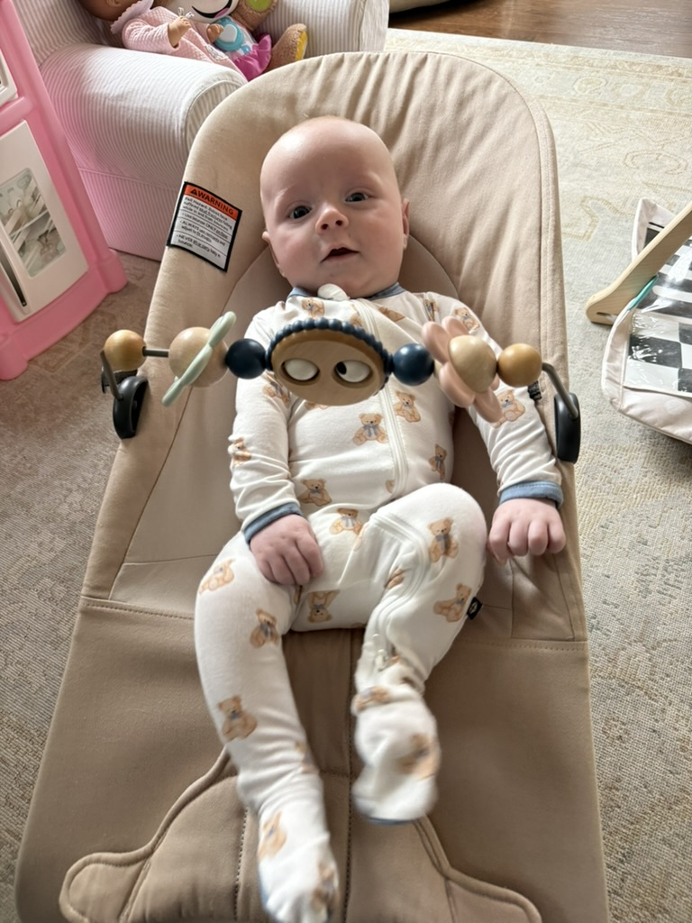
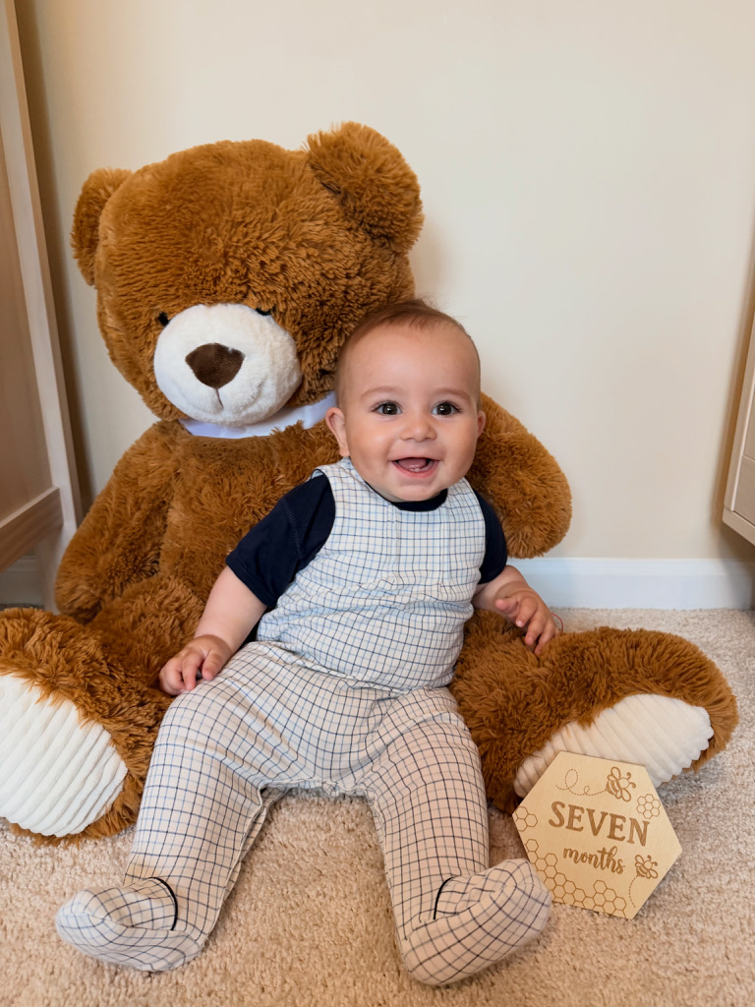

Slide 4
Today’s Objectives
Understand the Role of the Zone chairperson
Understand the Duties of the Zone Chairperson
Understand your role as an active member of the DG’s Team
Learn of the Tools Available for the Zone Chairperson
Share Best Practices within small-group discussions
Notes:
We have several objectives today to support you in becoming the best Zone Chairperson you can be. Our objectives today are:
Examine your role as a zone chairperson within the larger structure of the association.
Review your duties as defined by the International Constitution and By-Laws
Understand your role as an active member of the GMT/GLT
Learn about the tools available to you on the association website
Take the opportunity to share best practices with those at your table through small-group discussions; supported by our facilitators.
Let’s get started.

Slide 5
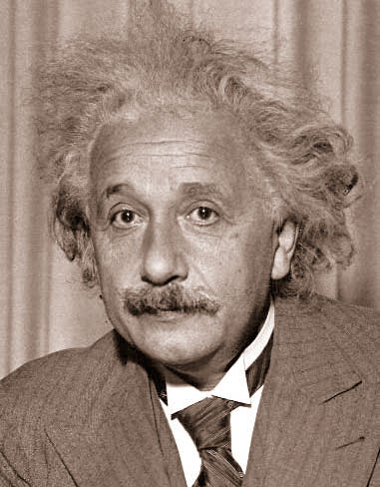
Problem Solving
“The significant problems we have cannot be solved at the same level of thinking with which we created them.”
Dr. Albert Einstein
Dr. Albert Einstein
Nobel Laureate
1879-1955

Slide 6
Keys to Success
Always apply commonsense.
Don’t be afraid to ask for help.
Each club is different.
Encourage people to share their successes.
Always treat people with respect.
“There ain’t no right way to do wrong.”
Be a great listener.

Slide 7

and the district leadership
  The Role of the Zone/Region Chairperson
The Zone/Region Chairperson is the LINK
between the clubs in the zone
Image courtesy of David Castillo Dominici / FreeDigitalPhotos.net
Notes:
Let’s start with the main role of the zone chairperson.
The Zone (or Region) Chairperson is the link
between the clubs in the zone (or region)
and the district leadership.

Slide 8
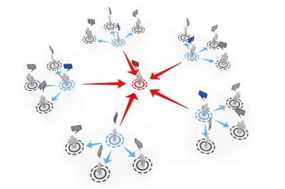
  The Role of the Zone Chairperson
Communicator
Counselor
Motivator
Notes:
As the LINK between the district and the clubs, the Zone/Region Chairperson serves as:
Communicator - Facilitating two-way communication between the district and the clubs
Through three zone meetings using the suggested agendas provided in the Zone Chairperson Manual
reporting back to the district leaders through the District Governor Advisory Report Forms
Counselor – Assisting clubs to achieve excellence and remain strong
Making sure that clubs are functioning per policy
Assisting with conflicts within clubs
Motivator – look for potential new leaders and communities not yet served by Lions
Recognize accomplishments of clubs and Lions in their zone
Help club officers effectively fulfill their current role and provide opportunities for club leaders to consider higher offices and enhance their leadership skills
Look for communities within their zones which would benefit from the services of a Lions clubs in their area

Slide 9

  The Duties of the Zone Chairperson
  Further the Purposes of the Association
  Chair the District Governor’s Advisory Committee meetings
  Include DG Team
  Report after District Governor’s Advisory meetings
Notes:
In fulfilling these key roles, the Zone Chairperson has many duties.
The Zone Chairperson is the chief administrator of his/her zone and has many responsibilities, including:
To further the Purposes of the Association
Chairs the District Governor’s Advisory Committee and calls regular meetings of that committee
Involves the District GMT/GLT and District Governor Team as special guests to a District Governor’s Advisory Committee meeting - to discuss membership and leadership development goals and assist with membership and leadership development within the zone.
Reports results of each District Governor’s Advisory Committee meeting to the district governor, region chairperson, GMT and GLT coordinators.

Slide 10
  The Duties of the Zone Chairperson
  Visit a regular meeting of each club
  Ensure that every club operates under a duly adopted constitution and by-laws
  Represent each club regarding problems
  Promote full club representation at all conventions
Notes:
Additional duties are:
Visit a REGULAR club meeting of each of the clubs in your zone
Ensure that every club operates under a duly adopted constitution and by-laws
Represent each club with any problems
Promote the district convention to the clubs and encourage full representation of each club at the district convention.

Slide 11
  The Duties of the Zone Chairperson
  Play an active role in organizing new clubs
  Support leadership development in the zone
  Supervise progress of district, multiple district and Lions Clubs International projects
Notes:
You will also work with the GMT/GLT and District Governor Team:
As an active member of the GMT, collaborate to organize new clubs
As an active member of the GLT, support leadership development in the zone
Promote the Club Excellence Process to the clubs within the zone and work in concert with the District GMT/GLT and the district governor team to implement the program within the zone.
Supervise club involvement in district, multiple district and international service projects

Slide 12

Communicate at Zone Meetings
Hold at least three zone meetings during the year.
Suggested agendas shown in the Zone Chairperson Manual
Schedule meetings soon after the cabinet meetings
Notes:
Zone meetings are a key way to COMMUNICATE
Your District Governor Advisory Meetings – Or Zone Meetings as we also call them, offer the opportunity for good communication, both from the district to clubs, and from clubs to district.
Hold at lease three zone meetings throughout the year, and change the meeting location to ease the burden of travel for club members to attend. You may wish to hold a fourth meeting of a more social nature for recognition purposes.
Refer to your Zone Chairperson Manual for suggested topics for your meetings. The Zone Chairperson Manual is available on the association website.
Schedule your zone meetings a week or so after the cabinet meetings so that you may communicate important information from the district to the clubs in your zone.

Slide 13

Some Tips for Great Zone Meetings
Make the meeting interesting
  full of information
  not too long
Use correct meeting procedure
Remember, you are in charge!!
Notes:
Some Tips for Great Zone Meetings
Be sure that your zone meetings are interesting
Make it full of information that is pertinent and important to the clubs
Keep the meeting on track and respect the time of attendees
By using good meeting procedures you will be able to demonstrate good leadership skills
Use correct meeting procedure including an agenda
print a copy off for each club present
stick to it
Finally remember you are in charge, and that includes keeping those who
have the floor to speak remain concise in their reports, so as to not take too much time.
Your leadership and enthusiasm will make the meeting something that
clubs will want to attend and will be seen as an informative communication
tool.

Slide 14
Some Tips for Great Zone Meetings
Select someone to keep the minutes for you
Alter the venues for each meeting
Invite a speaker on a subject you wish to promote
Notes:
Here are some helpful tips to increase the success of your zone meetings;
Recruit a good scribe to take minutes for you - you will be too busy to do it yourself.
Try not to have all the meetings in the same venue unless it is in the center of your Zone, this will share the clubs’ burden when it comes to traveling to the meeting.
Invite interesting speakers to share reports about their projects. You can use other Cabinet Officers to share as well, or include district chairpersons.

Slide 15
Reporting to the Cabinet
Prepare a report for the cabinet secretary. Include:
Membership of each club, net increase or loss
Projects clubs are undertaking
Concerns you have regarding the clubs
Recommendations you wish to bring before the cabinet
District Governor’s Advisory Committee Meeting Report
is now a writable.pdf (DA-ZCM)
Notes:
To prepare your report for the district cabinet, include:
Membership gains and Losses (the Club Health Assessment Report)
Interesting Projects being initiated by your clubs (Service Activities)
Any Concerns you have or problems being experienced by your clubs
Any Recommendations you would wish the cabinet to consider
The District Governor Advisory Meeting Report Form is available on the Association website. (DA – ZCM)
To assist the cabinet secretary, please furnish reports to him/her by the dates specified.

Slide 16

Be Well Prepared for Visits
Visit officially once per year to support the club and share district information
Prepare before your visit and be knowledgeable about the club and its projects
Always take a membership ceremony induction with you and an invocation. You never know when you might need them!
Be prepared to answer questions about Lionism in general, fees and dues, etc.
Notes:
In your role as a Counselor - All clubs in your zone should be visited at least once during your term as Zone Chair. Before you go – PREPARE!
Your visit may be completed
at a regular club meeting or
a business meeting
Before you go to your club visit
make sure you check for the club’s website.
become knowledgeable about its projects.
You may find it helpful to have a club roster as well.
Ask club leaders about their interests and how the district might support them.
Always take a induction ceremony with you and be ready to induct new members – and an invocation incase you are requested to do that honor.
Be prepared to answer questions from a wide range of subjects including International and District Dues. Time spent preparing for your visit will ensure a smooth time at the club

Slide 17
XXX Lions Club
Chartered: Date
Members: XX Members ( X woman, X family units )
Longest Lions membership, (X years of service) ; Newest Lions: X years of service
Melvin Jones Fellows:
Money in LCIF account for Melvin Jones Fellows:
Service Activities:
Reports:
Unique programs: (Ideas to share with other clubs)
Club attended Fall Conference
Club website: Facebook: Club bulletin: X Account:
President:
Secretary:
LCI Indebtedness:

Slide 18
Struggling Clubs
Status Quo Club
  Club desires to turn in charter or merge with another club (most common)
  Club does not uphold the principles of Lions Club International (involved in litigation, does not hold meetings)
  Club is fictitious (paper only)
  Club is behind on its dues to international

Slide 19
Struggling Clubs
Status Quo Club
  While in status quo, the club cannot
    1. Conduct service activities;
    2. Conduct fund-raising activities;
    3. Participate in district, multiple district, or international functions or seminars;
    4. Participate in any voting procedures outside of the club;
    5. Endorse or nominate a candidate for district, multiple district and international office;
    6. Submit the Monthly Membership Report and other report forms;
    7. Sponsor a Lions club, or organize a Leo club or a Lioness club.

Slide 20
Struggling Clubs
Priority Club
  DG may designate up to five clubs in the district.
  DG and club leadership must develop a plan to get the club back on the right track.
  Assign a Guiding Lion to the club.
  DG is authorized to make two additional visits per year to the club.
  DG will review the progress at the six-month mark to determine if the club should remain a priority.

Slide 21
Struggling Clubs
Financial Suspension
  Behind on paying outstanding debt to LCI for 120 days. March 2026 Board Policy Letter reduces the grace period to 90 days effective July 1, 2026.
  Remind clubs when international and state dues are required (July and Jan for international and Dec for state).
  Discuss with the leadership (may have a valid reason).

Slide 22
Payment Instructions
Logon to the portal, and you have several options to pay electronically
Pay by snail mail:
  The International Association of Lions Clubs
  35842 Eagle Way
  Chicago, IL 60678-1358
Email: accountsreceivable@lionsclubs.org
Phone: 1-630-203-3810

Slide 23

Counsel the Club to Strive for Excellence
Work with the district governor to ensure the clubs in the zone:
Meet on a regular basis
Abide by constitutional provisions
Demonstrate sound financial practices
Conduct service projects in the community
Maintain effective internal communications and a community public relations program
Implement membership recruitment, orientation and retention program
Encourage the development of new Lions leaders
Notes:
As a well-prepared Zone Chairperson; you will be ready to work with your clubs to ensure they;
Meet on a regular basis
Abide by constitutional provisions
Demonstrate sound financial practices
Conduct service projects in their communities
Maintain effective internal communications and a community public relations program
Implement membership recruitment, orientation and retention programs
Encourage the development of new Lions leaders

Slide 24
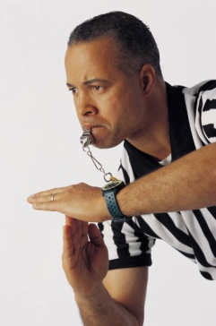
Counselor – Advisor – When Clubs Have Conflict
  Listen to both sides
  Be sure of your facts
  If in doubt, seek a separate opinion
  Club dispute resolution procedure
  in the Standard Club Constitution (Article X of Bylaws)
  For more information see the Lions Learning Center after logging into the Lion Portal, Click on the LEARN block.
Notes:
What should you do when people disagree? As a conflict advisor, you may be asked to advise on disagreements within clubs.
Remember to do the following:
Listen to both sides
Be sure of your facts – verify all that you are able to verify
If in doubt, seek a second opinion from a trusted confidant not directly involved with the conflict
Understand when it is appropriate to seek the use of the appropriate Dispute Resolution Procedure.
The Lions Learning Center contains additional self study on Conflict Resolution

Slide 25

MISSION OBJECTIVE
1.5 million Lions on July 1, 2027.
25
25
Notes:
Our goal is to achieve 1.5 million members by 2027.
That will require the commitment of every leader and every Lion.
And it will also require that we grow at every level of Lions.

Slide 26
Membership
Goal and Objectives
Lions Clubs International will reach 1.5 million members worldwide on July 1, 2027.
All districts will add new clubs.
All clubs will induct new members.
All CAs will achieve positive net growth.
Districts should incorporate regional strategies to attract a diverse membership, including women and young Lions.
26
Notes:
Every district will need to add new clubs.
Every club will need to add new members.
And every constitutional area will need to achieve positive net growth.
To be successful, we will need to focus on attracting a more diverse membership, including women and younger Lions who can carry our mission of service into the future.
Like we talked about, MISSION 1.5 will make us stronger at every level of Lions.

Slide 27


Available Resources
The Global Membership Approach provides a process and resources for all clubs and districts to achieve growth.
All the tools we need are already here!
lionsclubs.org/global
27
Notes:
We know it takes commitment to grow. But it also requires the right resources.
The Global Membership Approach provides a process and resources to help every district and club achieve growth.
The Global Membership Approach works.
It has been proven to be effective around the world, so let’s take advantage of the tools that are already available to us.

Slide 28
Mission
Amplification
SCAN ME
Our MISSION 1.5 landing page helps Lions learn about this exciting initiative and get the tools to take action.
28
Notes:
Lions International has created a special MISSION 1.5 webpage to help Lions learn about the initiative and find resources that can help them take action.
This is a great destination for Lions who want to see what MISSION 1.5 is about.
Please share the page with Lions so they can learn more—and do more—to help us grow.

Slide 29
Great Resources and References for You
  https://www.lionsclubs.org/en/resources-for-members/mission-to-grow
  https://www.lionsclubs.org/en/resources-for-members/resource-center/zone-region-chairpersons
Notes:
There are several good training and references to help prepare you fulfill your role as a Zone Chairperson.
Among those are:
Zone Chairperson Online Training
Zone Chairperson Training Workshop (Contact your GLT District Coordinator for more information)
Zone Chairperson Manual
Club Officer Manual
Standard Club Constitution and By-Laws (LA-2)
Board Policy Manual Chapter V - Clubs

Slide 30

Additional Ideas
  Review the requirements for awards
  Talk about service activity reports and the importance
  Share information
  Visit clubs outside zone
  Remind clubs that they should audit their accounts at least once a year
  Encourages clubs to provide a financial report at every board meeting
Notes:
Here are additional Tools to help you Support your clubs.
www.lionsclubs.org
PU-101 – Club officers reporting form
Club Excellence Award Application (DA-1)
Club Election Guidelines
Induction Ceremony
E-Clubhouse Application
Club Health Assessment Report - Use this report to look for trends or membership losses; indicating that a club is becoming weak and may need your assistance.
Membership Reports are on MyLCI Logon Page. There are several membership reports available in MyLCI on the Logon Page – you do not need to logon to gain access. Simply find the hyperlink on the right-hand side of the page.
Service Activity Reports for your clubs on MyLCI

Slide 31

Make it a Great Year and Celebrate Your Success!

Slide 32

The Ten Commandments of Leadership for Lions
1. People are illogical, unreasonable and self-centered.
Love and trust them anyway.
2. If you do good, people will accuse you of selfish ulterior motives.
Do good anyway.
3. If you are successful, you will win some false friends and true enemies.
Do good anyway.
4. The good you do today will be forgotten tomorrow.
Do good anyway.
5. Honesty and frankness will make you vulnerable.
Be honest and frank anyway.

Slide 33
The Ten Commandments of Leadership for Lions
6. The biggest people with the biggest ideas can be shot down by the smallest people with the smallest ideas.
Think big anyway.
7. People favor underdogs, but follow top dogs.
Fight for the underdog anyway.
8. What you spend years building may be destroyed overnight.
Build anyway!
9. People really need help, but may attack you if you do help.
Help people anyway.
10. Give the world the best you got and you may get kicked in the teeth.
Give the world the best you have anyway.

Slide 34
• Bland Memorial
• Canine Companions
• Diabetes Awareness
• Environmental
• Global Outreach / Club Twinning
• Hearing Aid Bank Foundation
• Hearing Conservation
• International Relations
• Leader Dogs for the Blind

Slide 35
• Leo Clubs
• LCIF
• State Foundations
• Eye Banks

Slide 36
• Peace Poster
• Sight and Hearing Mobile Screening Units
• Portable screening instruments
• Special Needs Equipment
• White Cane
• Youth Camps and Exchange

Slide 37
GLT: Identify candidates for the RLLI. Plan and coordinate District Officer Training Schools. Provide remedial and targeted training where needed within the District to assure that all Club and District Officers are functionally able to do their jobs well.

Slide 38
Visitation: Promote Fun and fellowship with the Clubs and District. Encourage the exchange of ideas and traditions by promoting an environment of sharing and involvement between clubs and their members. Schedule and coordinate the annual Visitation / Awards Dinner.

Slide 39
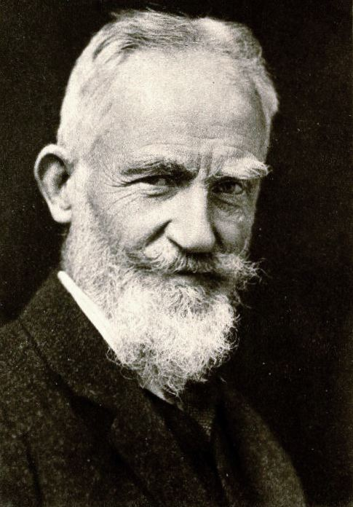
“If you have an apple and I have an apple and we exchange these apples then you and I will still each have one apple. But if you have an idea and I have an idea and we exchange these ideas, then each of us will have two ideas.”
George Bernard Shaw

Slide 40
Four of the Hardest things to say
I am sorry.
I was wrong.
I need help.
Worcestershire sauce

Slide 41
Questions

Slide 42

2026-27 MD24-L
Theme
“Dare To…” is a powerful call to action. It challenges us to dare to lead with courage, dare to innovate, dare to change, dare to embrace challenges, and dare to envision a future bigger than ourselves.

Slide 43

Every Month a new word will be added to “Dare To…”
July 2026 – Dare To Lead
August 2026 – Dare to Explore (Visitation)
September 2026 Dare To Engage (Fall Conference)
October 2026 – Dare To Roar
November 2026 – Dare To Serve
December 2026 Dare To Remember

Slide 44
Every Month a new word will be added to “Dare To…”
January 2027 Dare To Imagine (Mid- Winter
February 2027 Dare To Inspire
March 2027 Dare To Grow
April 2027 Dare To Learn
May 2027 Dare to Shine (State Convention)
June 2027 Dare to Celebrate

Slide 45
Important Dates and Locations:
Installation – July 18th Blue Ridge Café, Ruckersville
Visitation – August 22nd – Remington Lions Club, Remington
Fall Conference September 19th – Weyers Cave Community Center, Weyers Cave
Mid-Winter Conference – 2nd or 3rd Saturday of January
MD24 State Convention – May 27th – 30th – Harrisonburg VA

Slide 46
Weeks of Service 2026-27
October 8th- 18th – Vision
February 12th- 21st – Youth / Childhood Cancer
May 29th – June 6th - Environment

Slide 47
Your Role as Zone Chair
1. To be the voice, eyes and ears of the District
2. You are the CRL – Chief Roaring Lion for the Zone
3. Keep your clubs engaged and motivated to Serve

Slide 48

New MD24-L Lion Honor
Given to one member of every club based on a new or innovative initiative for service, fundraiser or fellowship.

Slide 49
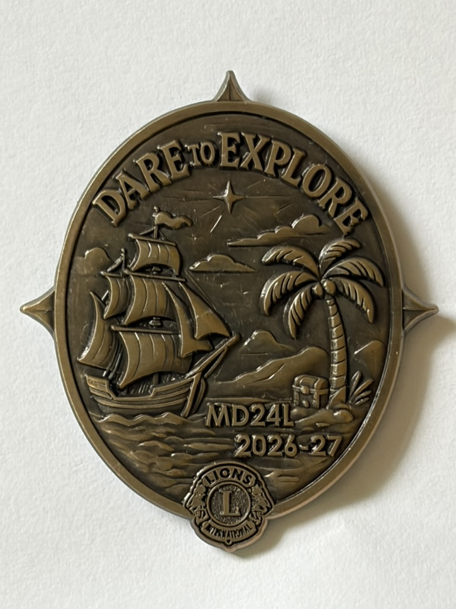

Visitation and Awards
August 22
Remington
Celebration of last year’s accomplishments

Slide 50

MD 24-L Fall Conference
Weyers Cave
Community Center
September 19th 2026
9:00am – 5pm
Visiting International Director Liz Crooke
From California
*Think Star Trek
*Lions Living in a Star Trek Environment
*What Does our future entail

Slide 51
Fall Conference Activities
One Day Event
Canine Companions – New Hearing Dog Program
Disaster Preparedness Program – Packing Disaster Preparedness Kits
Partnership with VSDB
Peace Poster / Essay Contest
Bland – Rebuild / Re-energize
Listen Up
Town Hall with Visiting ID – Liz Crooker

Slide 52
Fall Conference
Zone Support:
Zone Baskets like last year.
Local Zone help with set up / take down
--------------------------------------------------------------------------------------------------------------------------------------
Lunch Catered by Dayton Catering – Full Spread – You will not go hungry!!!
Ice Cream Treat from Smiley’s Ice Cream at the end of the day.
Reward yourself for a great day of fellowship, learning and collaborating.

Slide 53

MD24-L
Mid-Winter
January 2027
Location - TBD
While It’s cold outside. Let’s Imagine our future.

Slide 54

MD24
State Convention 2027
May 27th – 30th 2027
Hotel Madison
Harrisonburg, VA
Time to celebrate and let our successes shine bright!!!

Slide 55
1st Zone Meeting
Pass out Directories to clubs that are present
Discuss Fall Conference
Discuss everyone’s club goals for the year
Share State Achievement and Club Excellence requirements
Share New Visitation Program
Discuss Spark Plug Award
Share IP Mark Lyons’ International Theme
Overall Meeting Objective: MLFA (Making Lions Fun Again)
Stress “Stop the Drops”

Slide 56
2nd Zone Meeting
Discuss Winter Conference
Follow up on Club Goals (including Membership)
Discuss Kindness Matters
Encourage Club Interaction
Discuss the Ripple Effect
Investigate Partnerships

Slide 57
3rd Zone Meeting
Discuss Succession Planning for next year
Celebrate your successes
Get ready for State and International Convention

Slide 58
Lions International Changes:
Weeks of Service – Vision / Youth – Childhood Cancer / Environment
Invoices now due before 90 days was 120 days
Presidents, Secretaries and Treasurers can go on-line to see bills
Membership Goals for MD 24 L
1 New Club 1 New Leo Club +28 Members By Year End(after drops)
Membership Months: September and March

